Slide 1
INTELLIGENT AUDIO ENHANCEMENT
SECOND-YEAR ECE PROJECT
in Noisy Environments Using Analog Electronics, Digital Signal Processing, and Machine Learning
SMART AUDIO LAB
Project Presentation | Electronics & Communication Engineering

Slide 2
01 | Problem & Motivation
Why environmental noise matters in speech-oriented settings
Background sounds can mask speech and reduce listening comfort.
Audio systems need to inspect signals before choosing how to process them.
A low-cost learning platform can make audio processing concepts visible and testable.
The project explores a unified path from audio input to DSP, features, and ML demonstration.
CORE CHALLENGE
Separate useful speech characteristics from unwanted environmental sound without damaging the speech.
PROJECT RESPONSE
Build a modular dashboard to visualize audio, apply basic processing, and demonstrate feature-based classification.
ENGINEERING APPROACH
Combine analog front-end concepts, digital signal processing, and a machine-learning workflow.

Slide 3
02 | Aim & Objectives
A demonstrator for learning and evaluating an audio-processing pipeline
01 Acquire audio
Synthetic signals and short, on-demand laptop microphone recordings.
02 Visualize
Inspect waveform and frequency content using FFT.
03 Process
Demonstrate DC offset removal, low-pass filtering, and energy gating.
04 Extract features
Calculate RMS, ZCR, spectral centroid, roll-off, and low-band energy ratio.
05 Demonstrate ML
Show the feature-to-Random-Forest classification workflow.

Slide 4
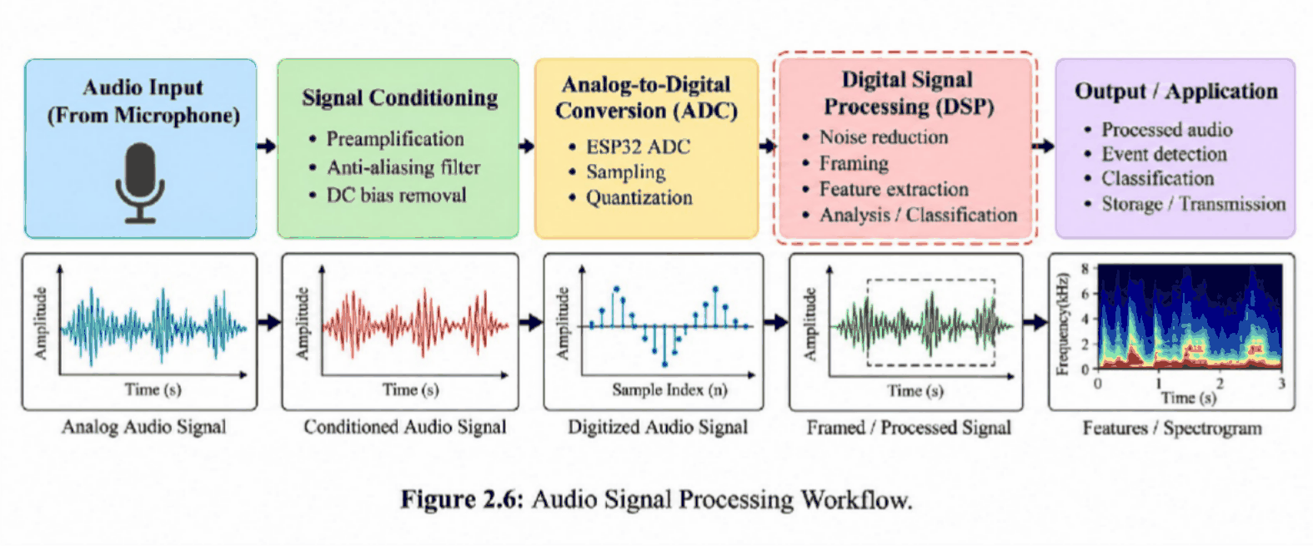
03 | Proposed System Architecture
Implemented software pipeline with a proposed hardware acquisition path
INPUT
Synthetic audio or on-demand microphone capture.
SOFTWARE
DSP → feature extraction → Random Forest demonstration.
HARDWARE STATUS
Analog conditioning and ESP32 acquisition are proposed unless physically built and tested.
Conceptual architecture illustration — not a claim of completed hardware integration.

Slide 5
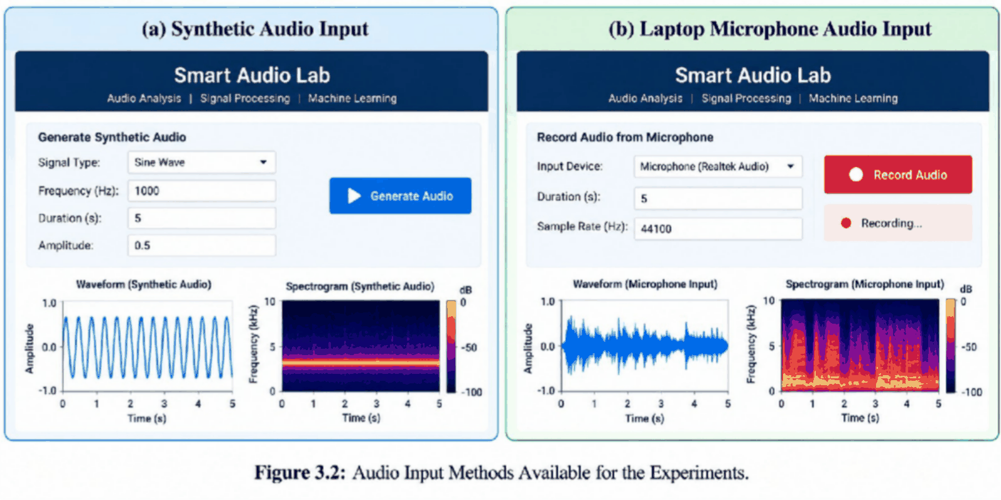
04 | Audio Inputs & Experimental Setup
Two software-supported input routes
SYNTHETIC INPUT
Useful for controlled demonstrations of signal characteristics.
MICROPHONE INPUT
Short recordings initiated on demand; not continuous real-time capture.
Record the source type for every example: synthetic simulation, laptop microphone, or physical hardware.

Slide 6
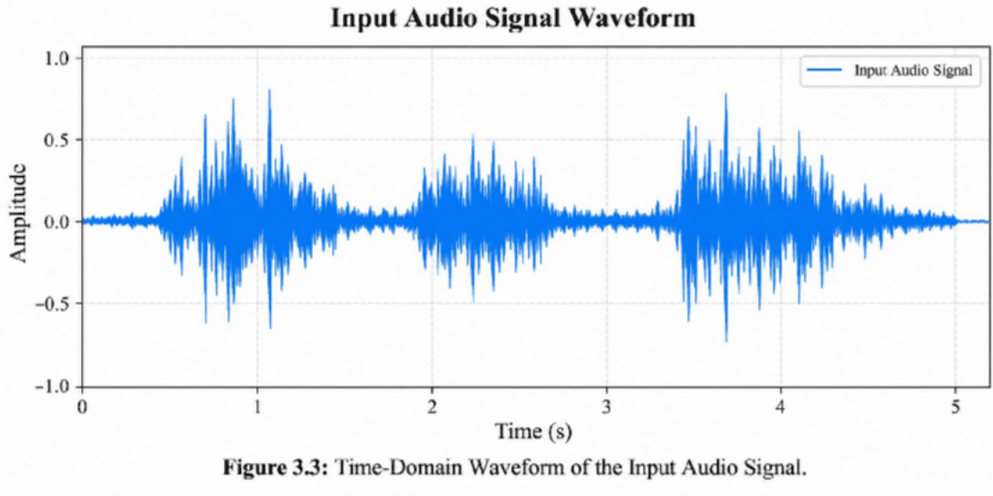
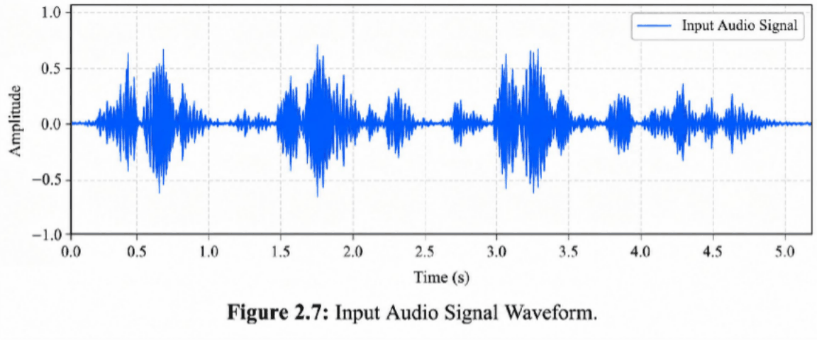
05 | Signal Analysis: Time & Frequency
Waveform and FFT provide complementary views of audio
TIME DOMAIN
Amplitude changes over time.
FREQUENCY DOMAIN
Distribution of spectral components.
Plots are illustrative examples; replace with exports from the actual application when available.

Slide 7
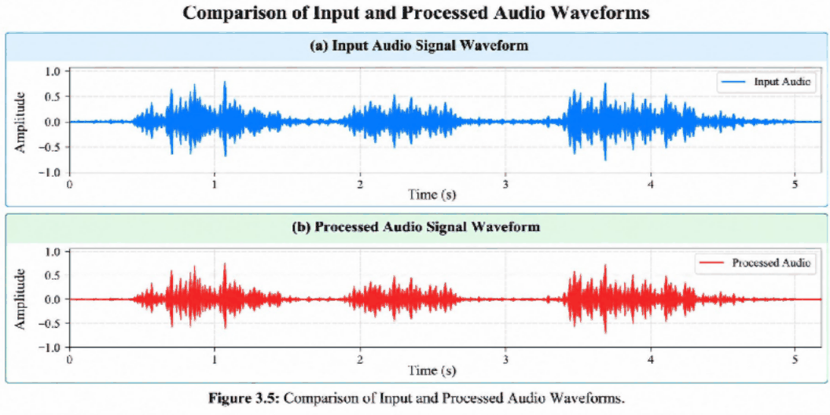
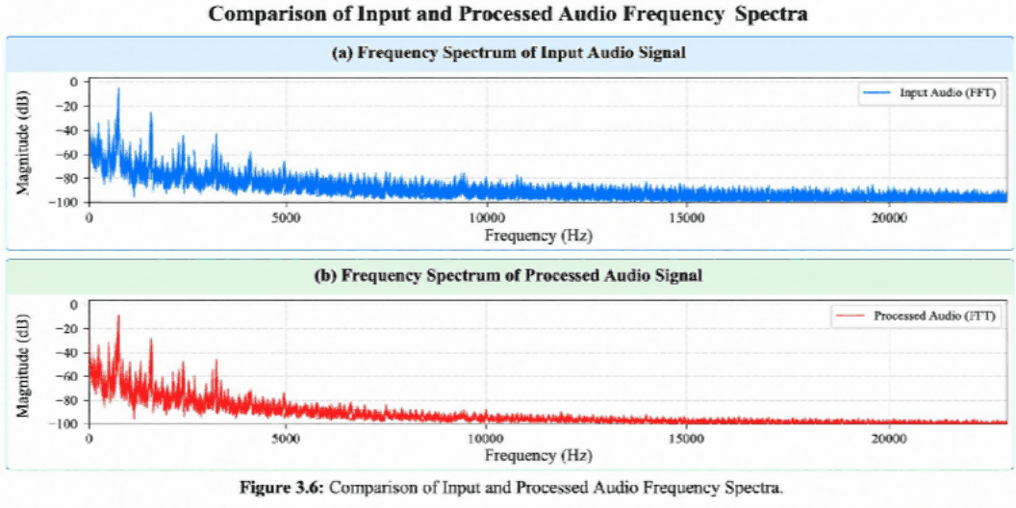
06 | Digital Signal Processing
Three basic operations demonstrated in Smart Audio Lab
DC OFFSET REMOVAL
Subtracts the signal mean to move the waveform toward zero.
BUTTERWORTH LOW-PASS
Attenuates components above a selected cutoff frequency.
ENERGY GATING
Attenuates signal regions below a selected energy threshold.
Important: basic filters and gates can also attenuate useful speech. Visual differences alone do not prove a measured SNR improvement.

Slide 8
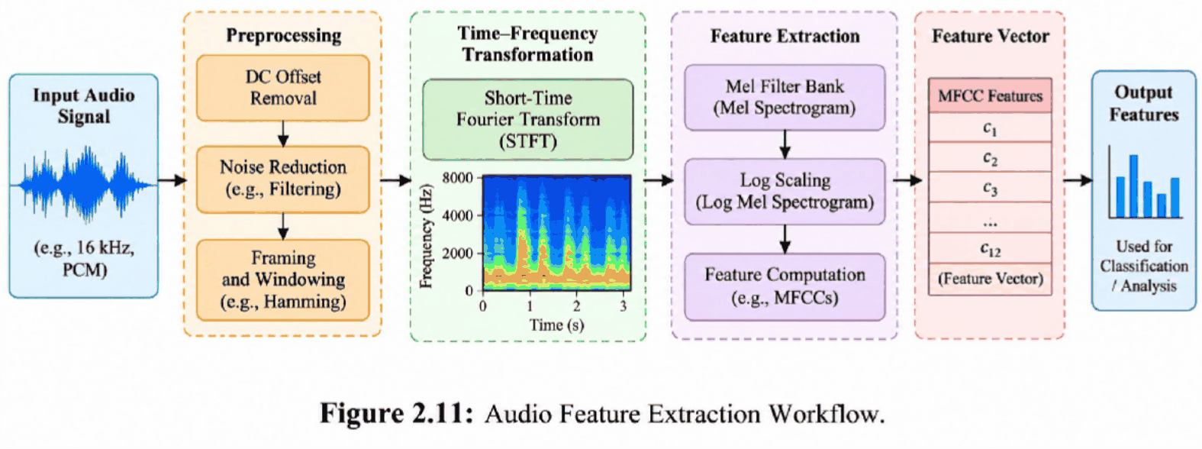
07 | Audio Feature Extraction
Compact numerical descriptors for the ML demonstration
RMS energy — overall signal magnitude
Zero-crossing rate — sign changes Spectral centroid — spectral balance Spectral roll-off — frequency threshold
Low-band energy ratio — energy in a defined low band
Feature values depend on the signal, sampling rate, and implementation.

Slide 9
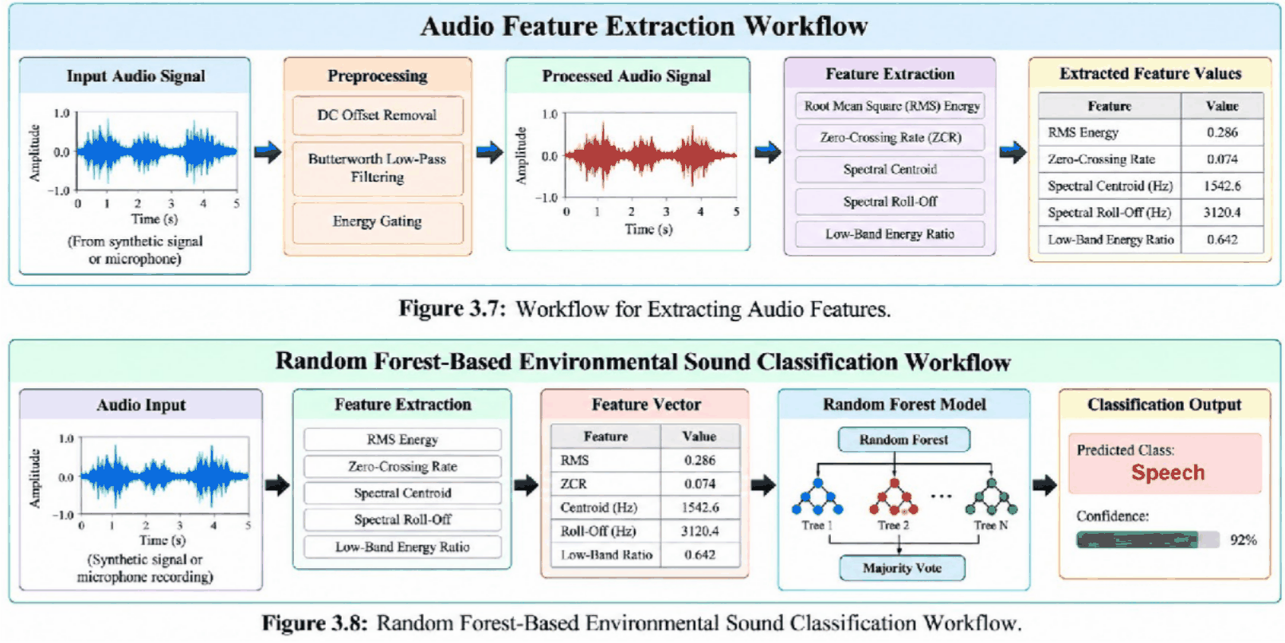
08 | Random Forest Demonstration
Feature vector → tree ensemble → predicted class
WHAT IT SHOWS
How extracted features can be passed into a classifier.
WHAT IT DOES NOT SHOW
Validated real-world environmental sound recognition accuracy.
Current demonstration uses synthetic feature examples. Any sample class/confidence shown in artwork is illustrative only.

Slide 10
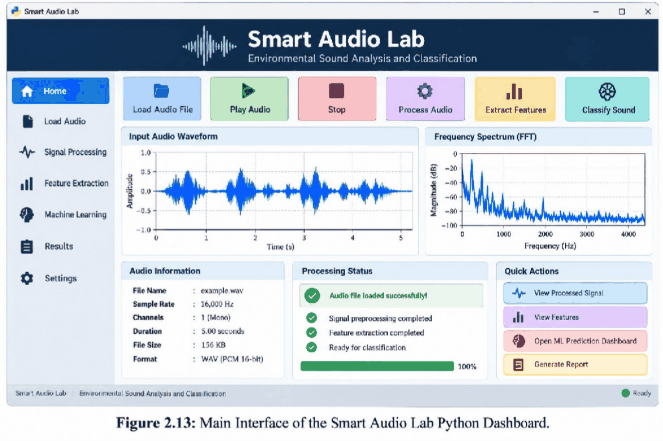
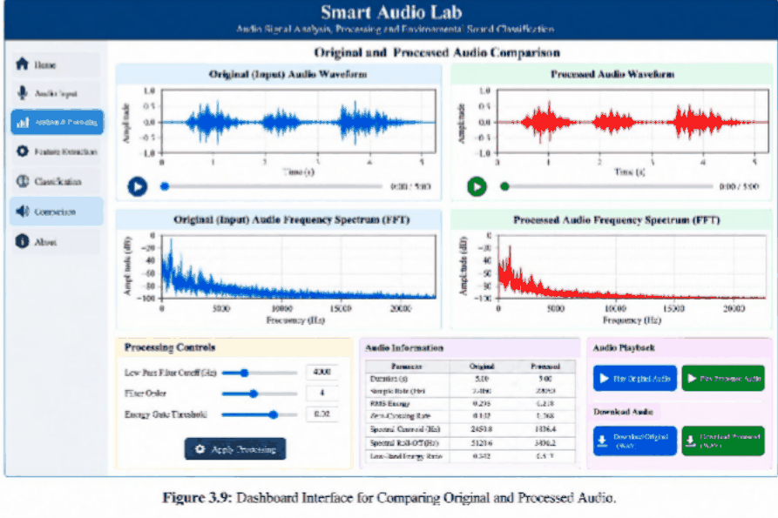
09 | Smart Audio Lab Interface
A unified workspace for analysis, processing, features, and comparison
Interface images are visual mock-ups; use genuine screenshots from the running Streamlit app for the final defense.

Slide 11
10 | Outcomes, Scope & Limitations
Separate implemented functions from proposed work
SOFTWARE DEMONSTRATED
Synthetic audio and on-demand mic capture
Waveform and FFT visualization
DC removal, low-pass filter, energy gate
Feature extraction and synthetic-feature RF demo
NOT YET CLAIMED
Validated real-world ML accuracy
Measured SNR or intelligibility improvement
Measured end-to-end latency
Completed analog/ESP32 hardware results
The project’s contribution is a unified, explainable software demonstrator and a proposed route toward hardware integration.
Next evaluation: real labeled recordings, controlled noise tests, objective metrics, and listening tests.
Next hardware step: assemble and verify the analog front end and ESP32 sample-transfer path.

Slide 12
11 | Conclusion & Future Work
From an educational demonstrator toward a validated integrated system
CONCLUSION
Smart Audio Lab brings audio visualization, basic DSP, feature extraction, and an ML workflow into one application.
NEAR-TERM
Evaluate using labeled real-world recordings; report reproducible metrics and limitations.
LONG-TERM
Integrate analog conditioning and ESP32 acquisition; investigate stronger noise-reduction methods.
Thank you
Questions & Discussion
Selected references: Oppenheim & Schafer (2010) • Breiman (2001) • Pedregosa et al. (2011)

